Slide 1
Understanding Parkinsons Disease
Fiona Wheeler

Slide 2
Parkinsons Disease Everyone different
.

Slide 3
Parkinsons Disease
Briefly …… What it is
Main symptoms,
Non-motor symptoms
Treatments
Resources and help
Life with my husband & PD

Slide 4
.
Progressive
fluctuating
neurological condition
Person not being difficult or not trying

Slide 5
.
One in 500 people
Most diagnosed between 55-74
127,000 cases in UK*
All ethnic groups
One in 20 diagnosed under age of 40

Slide 6
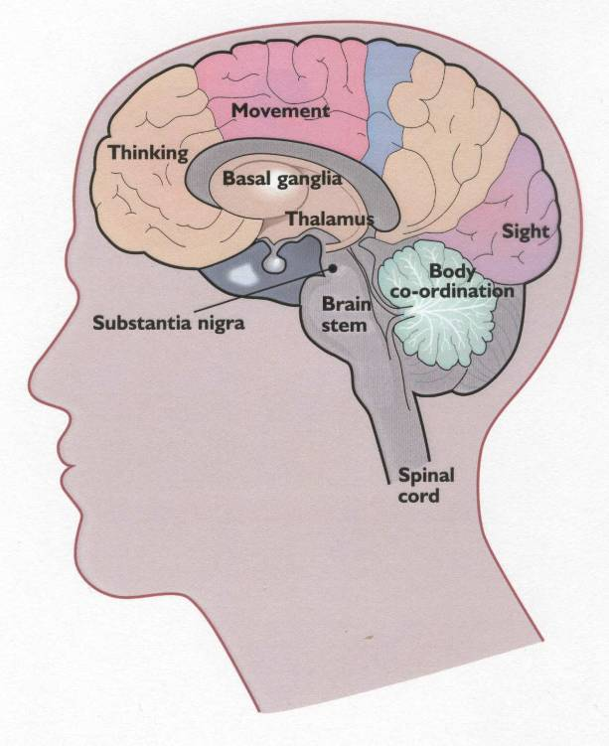
,
Dopamine-producing cells lost, part of brain controlling movement
Cause unknown
No cure
Rarely directly inherited

Slide 7
Lack of dopamine
Movement
Non-motor symptoms
Can affect cognition, behaviour and mood

Slide 8
.
Slow movement
Rigidity
Tremor
Postural instability

Slide 9
Some symptoms
Speech, communication
Posture
Balance
Motor freezing
Lack of facial expression
Swallowing
Excess saliva, drooling
Pain
Handwriting
Constipation
Incontinence
Depression
Dementia
Excessive tiredness
Sleep disorders
Anxiety
.
.

Slide 10
Resources
GP
Neurologist/geriatrician@ interest in PD
Parkinsons nurse specialist
Social services
Physiotherapist, occupational therapist, dietician, speech and language therapist
Carers organisations

Slide 11
Parkinsons UK
Parkinsons UK website, factsheets, info
Local advisor
Helpline, expert information,
Campaign, research,
Local groups support,
Professionals network
Excellence network – training

Slide 12
Treatments
Drugs
(Surgery – suitable for some people)
Treatments to improve quality of life
Do not alter course of PD
Effective for some time

Slide 13
Drugs
Complex,
Small changes.
Don’t stop suddenly.
Regular specialist review
Side effects
Late stages - problems swallowing – ?? help needed

Slide 15
Dementia, cognitive impairment, hallucinations
1) Delayed reaction
2) Cognitive impairment,
3) Dementia (40% eventually)
4) Hallucinations

Slide 17
Depression …..
“My legs are so weak, pain, weakness. I don’t always have all my marbles, I can’t communicate.’’

Slide 19
Thank you
fionawheeler@btinternet.com

Slide 21
Neuropsychiatric problems 1
Nocturnal non-motor symptoms
REM sleep behaviour disorder
Restless legs
Anxiety disorders
Apathy
Depression
Excessive daytime sleepiness

Slide 22
Neuropsychiatric problems 2 Autonomic disturbance
Psychosis and visual hallucinations
Dementia
Sensory disturbance & pain
Sensory type pains, from motor fluctuations, rigidity etc.
Bladder
Postural hypotension and more

